Slide 1
Investigating transformations with GeoGebra
Transformations

Slide 2
how to use Oak lessons

Slide 3
I can investigate transformations using dynamic software.

Slide 4
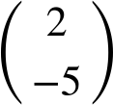
The object is the starting figure, before a transformation has been applied.
The image is the resulting figure, after a transformation has been applied.
A vector can be used to describe a translation. The vector shows the translation 2 units right and 5 units down.

Slide 5

Investigating transformations with GeoGebra
Using GeoGebra for rotations and enlargements
Using GeoGebra for reflections and translations
Using GeoGebra to identify transformations

Slide 6
Using GeoGebra for rotations and enlargements
Dynamic geometry software can be used to quickly draw shapes and transform them.
It is called ‘dynamic’ because items can be moved and manipulated after they have been created.
This means that if we perform a transformation incorrectly to begin with then we can adjust it to make corrections.

Slide 7
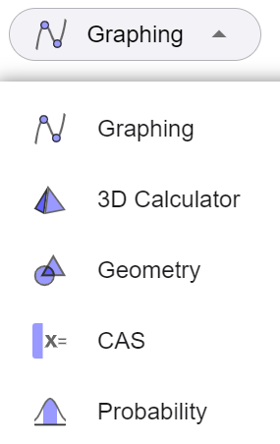
Using GeoGebra for rotations and enlargements
To get started:
Open up a web browser and go to GeoGebra.org
Find and press the ‘start calculator’ button.
Find and press the ‘graphing’ button to open up an options menu.
Select ‘geometry’.

Slide 8
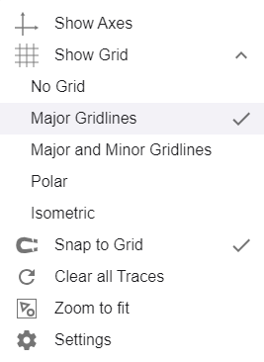
Using GeoGebra for rotations and enlargements
To change the background:
Click on the cog in the top right of the screen.
Select Show Grid.
From the drop down menu, select Major Gridlines.

Slide 9
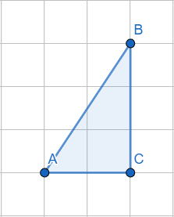
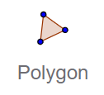
Using GeoGebra for rotations and enlargements
How to draw a polygon:
Click on the polygon tool.
Click on the workspace to insert some vertices.
Click on the first vertex again to complete the polygon.

Slide 10
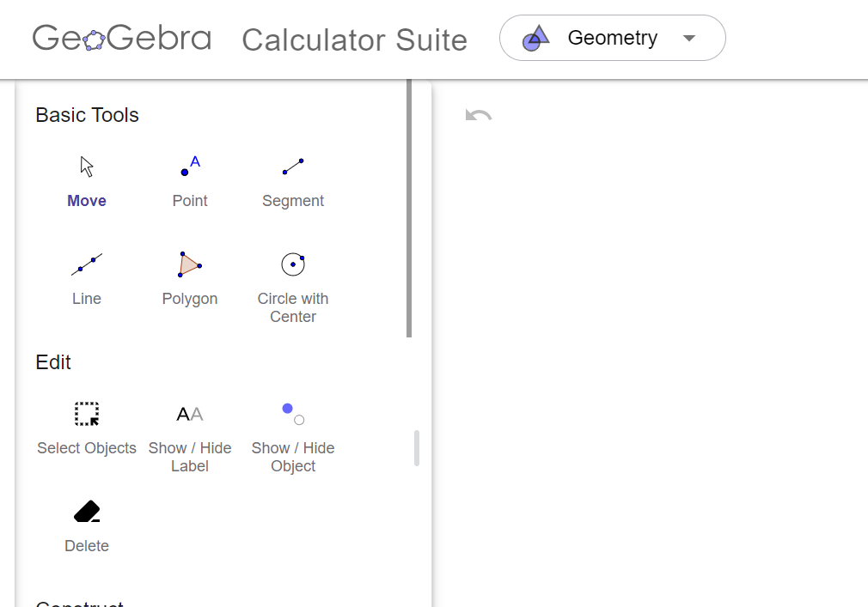
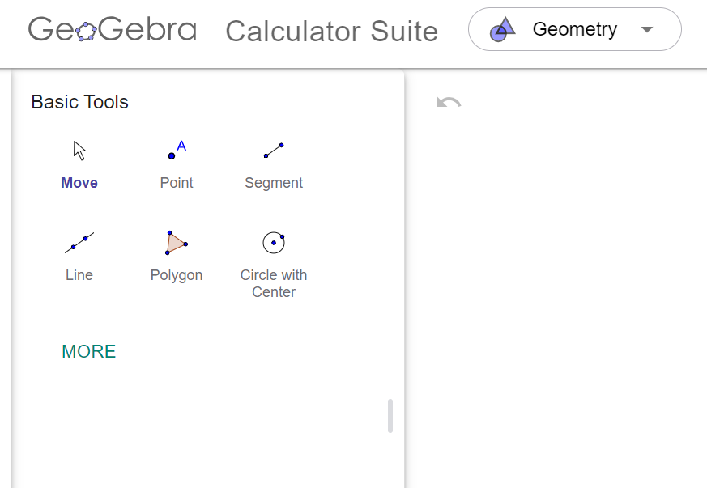
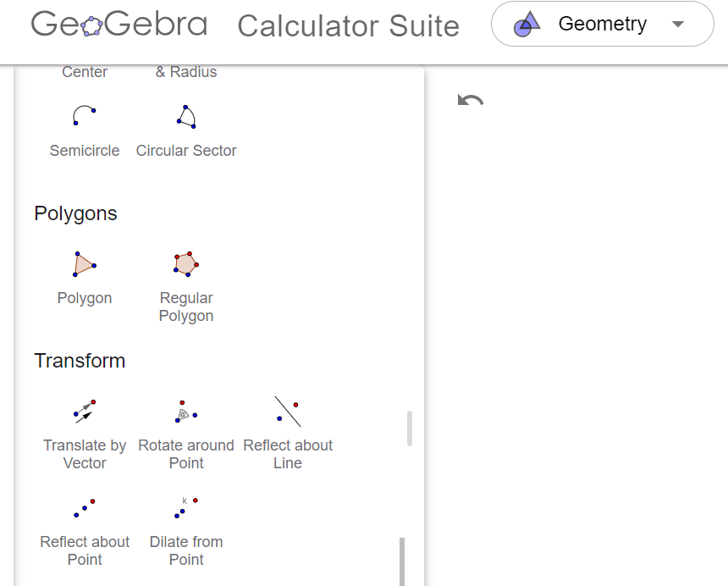
Using GeoGebra for rotations and enlargements
To get started:
Click ‘more’ to access more tools.
Scroll down to see full range of tools available.
Find the ‘transform’ section of tools.

Slide 11
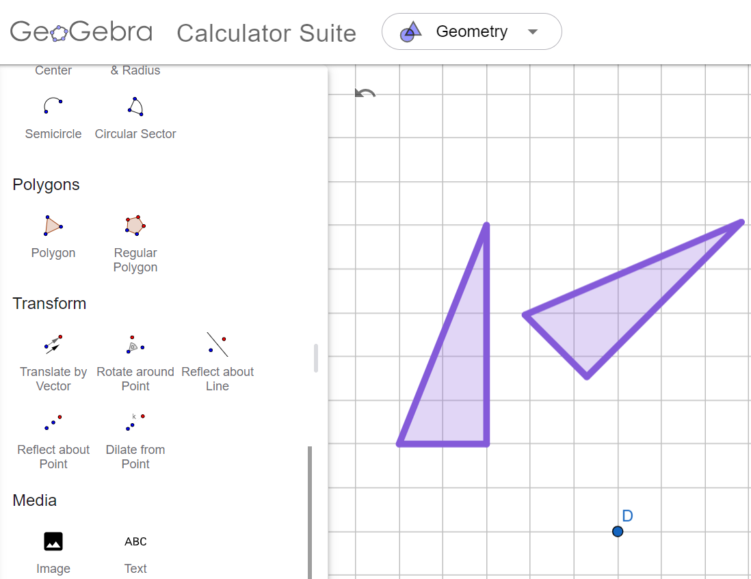
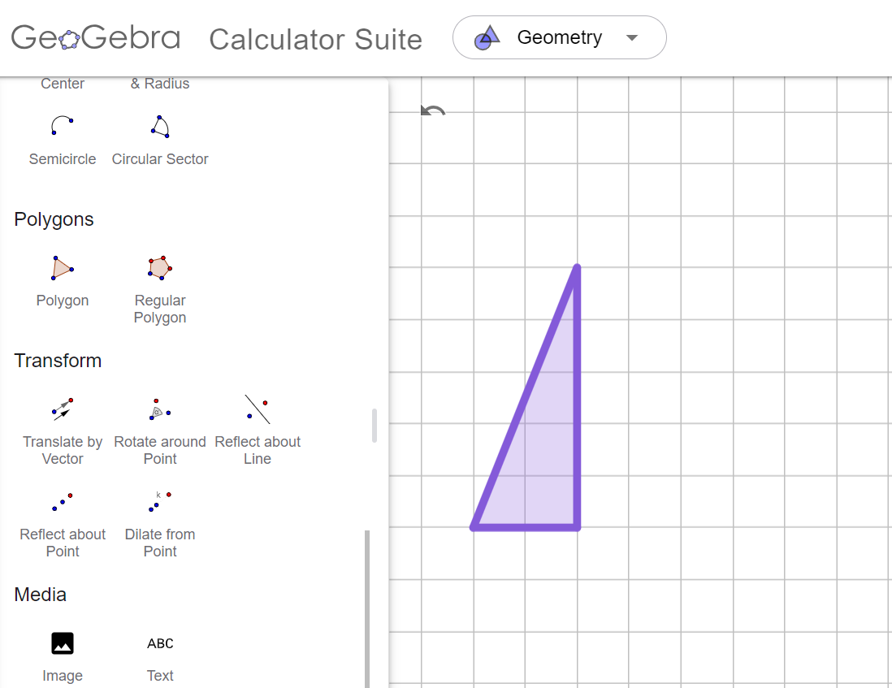
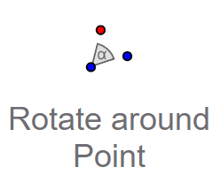
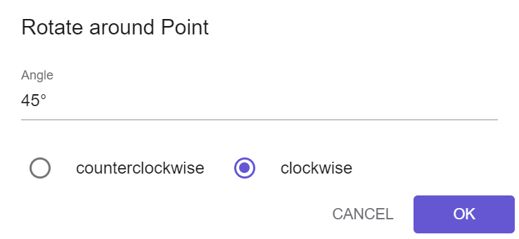
Using GeoGebra for rotations and enlargements
How to rotate an object:
Click the ‘rotate around point’ tool.
Click on the object and click a point for the centre of rotation.
Type an angle, select either clockwise or counterclockwise and click OK.
Counterclockwise is a word used in the USA to mean anticlockwise.

Slide 12
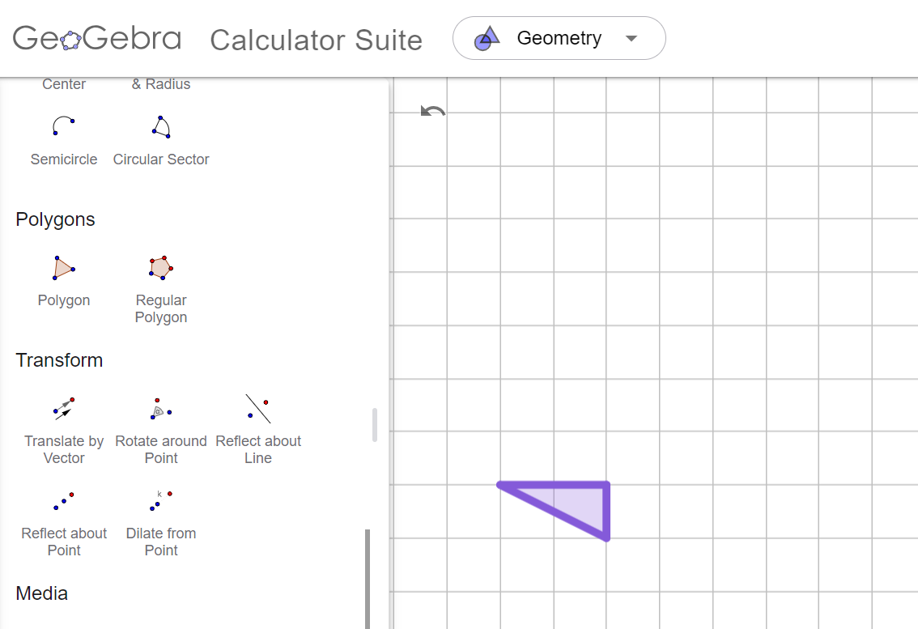
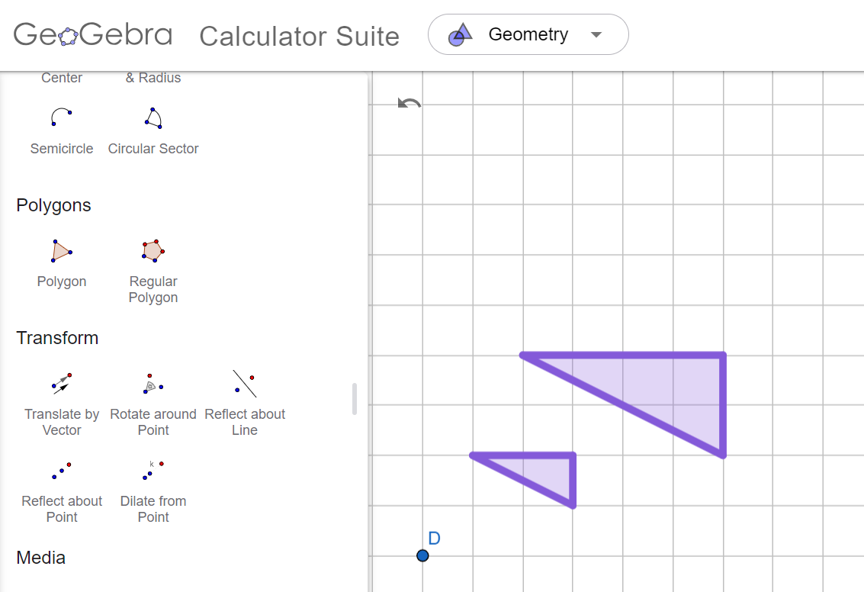

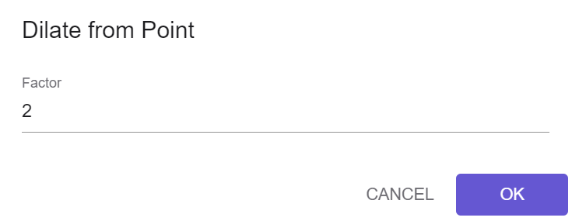
Using GeoGebra for rotations and enlargements
How to enlarge an object:
Click the ‘dilate from point’ tool.
Click on the object and click a point for the centre of enlargement.
Type in a value for the scale factor and press OK.
In the USA, the word dilate is used instead of enlarge to mean a transformation that causes a change in size.

Slide 13
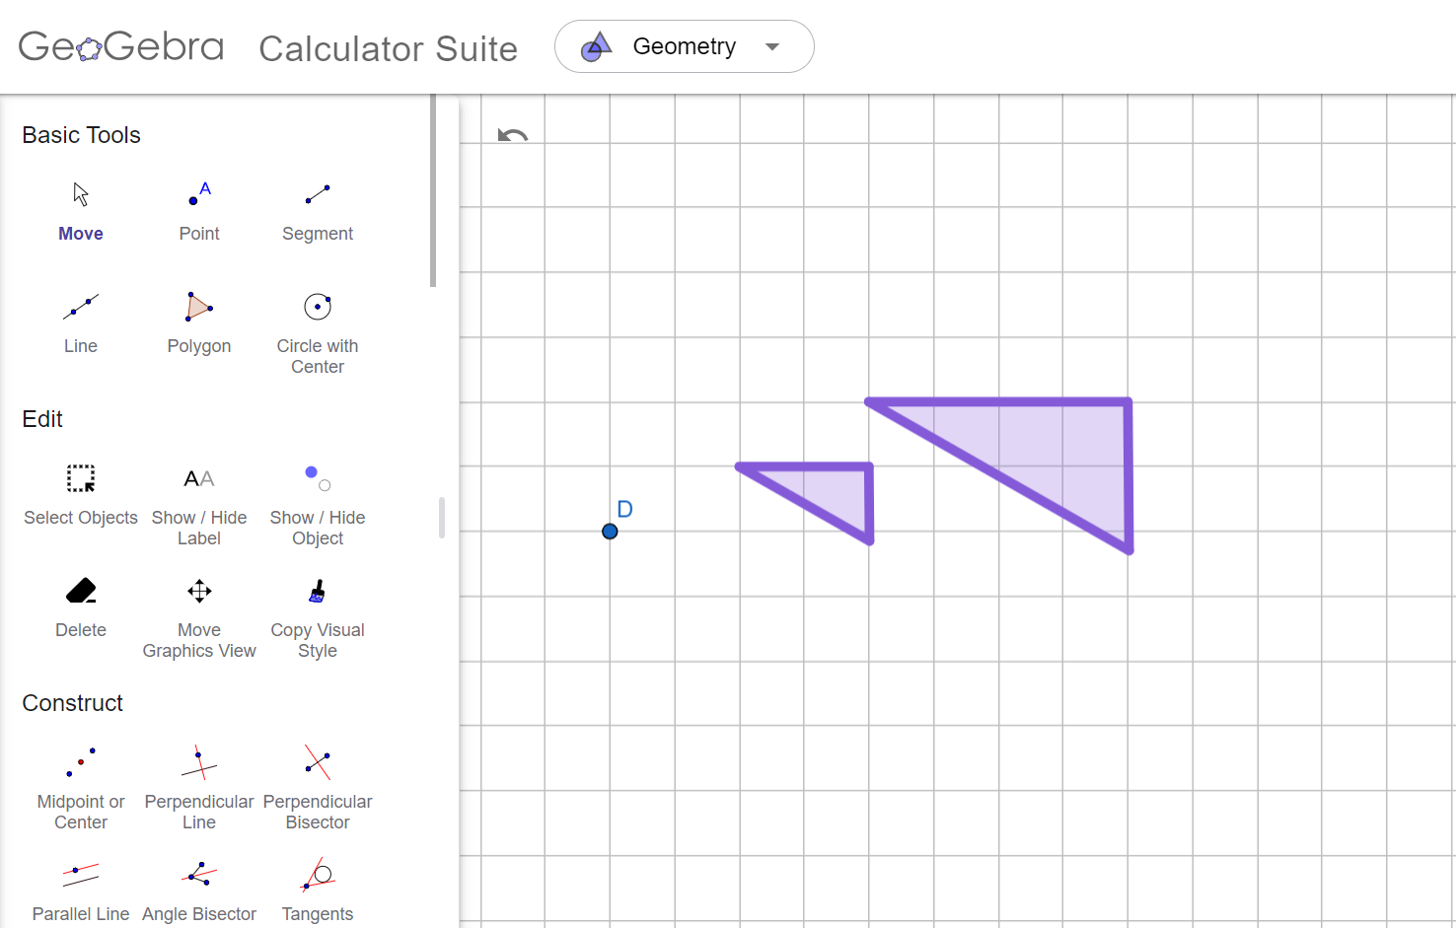
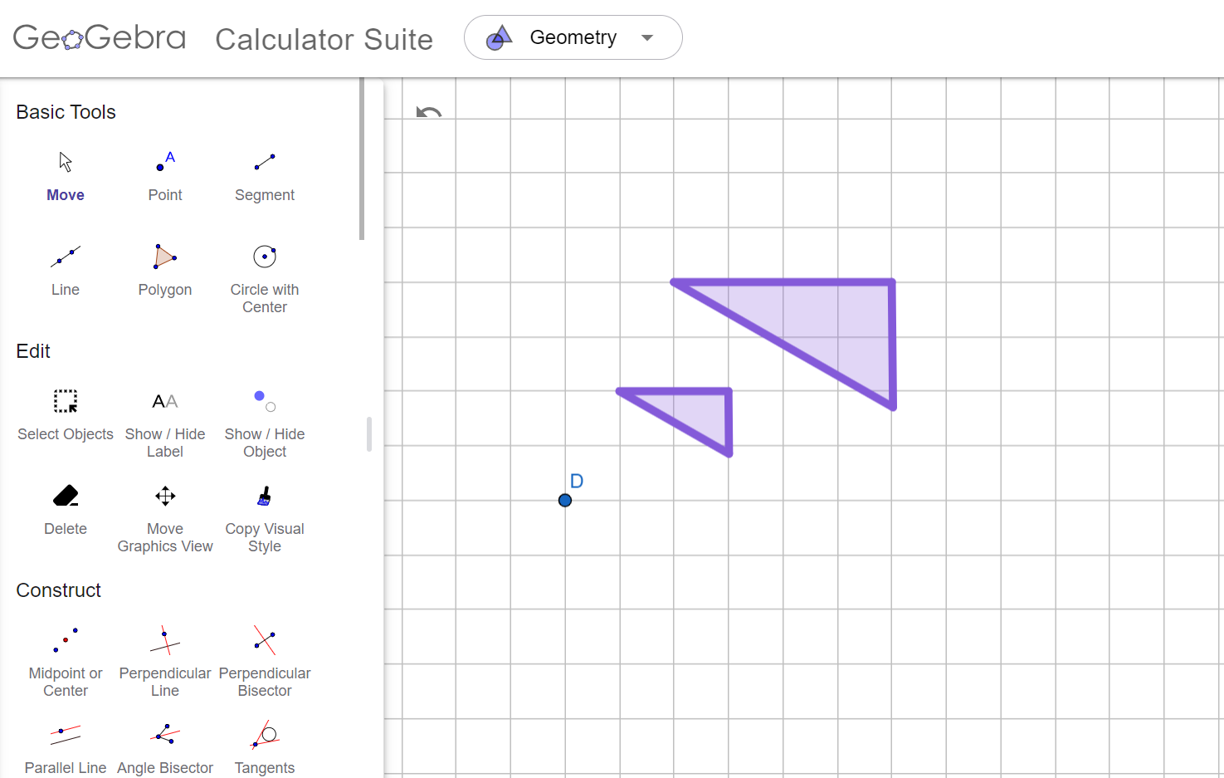
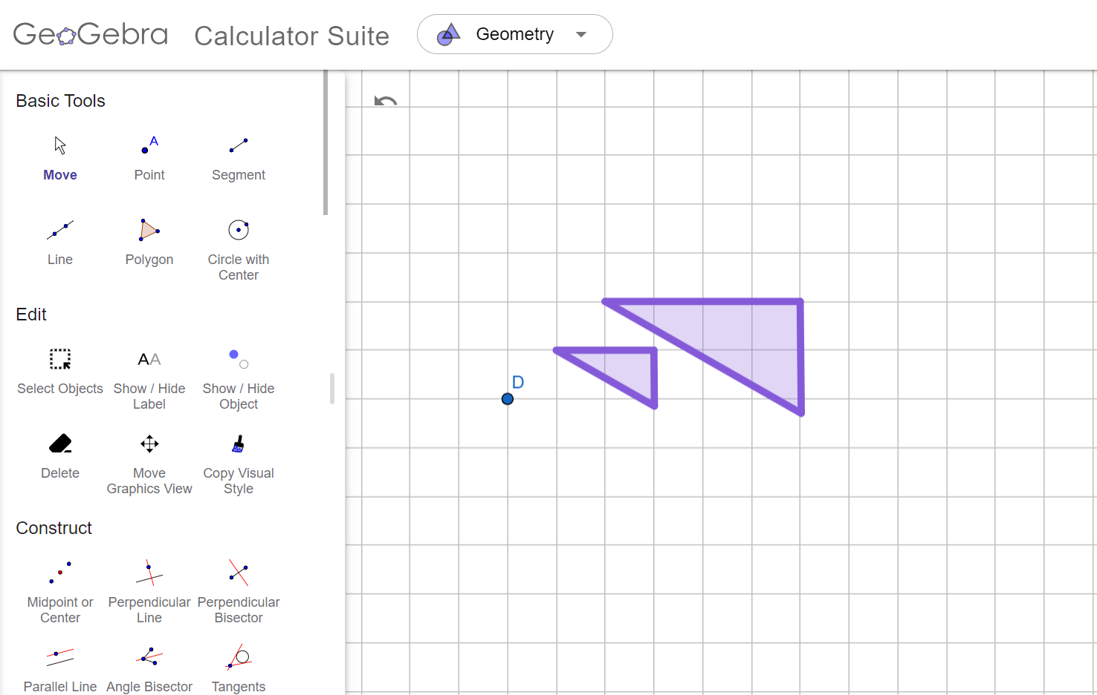
Using GeoGebra for rotations and enlargements
When doing rotations and enlargements on dynamic software, the centre point can be moved after the image has been created.

Slide 14

Using GeoGebra for rotations and enlargements
In GeoGebra, what button allows you to perform a transformation that causes a change of size?
Dilate from point
Enlarge from point
Shrink from point

Slide 15
Using GeoGebra for rotations and enlargements
What word is used in the USA for ‘anticlockwise’?
counterclockwise

Slide 16
Using GeoGebra for rotations and enlargements
1) Task A Question 1 🖇 Enlarge object A onto image A′.
a) What is the scale factor?
b) At what coordinate is the centre of enlargement?
2) Task A Question 2 🖇 Enlarge object B onto image B′.
a) What is the scale factor?
b) At what coordinate is the centre of enlargement?

Slide 17
Using GeoGebra for rotations and enlargements
3) Click here: Task A Question 3 🖇 Rotate object C onto image C′.
a) What is the angle of rotation?
b) At what coordinate is the centre of rotation?
4) Task A Question 4 🖇 Use the slider to rotate object D onto image D′.
a) What is the angle of rotation?

Slide 18

Using GeoGebra for rotations and enlargements
1) Task A Question 1 🖇 Enlarge object A onto image A′.
a) What is the scale factor?
b) At what coordinate is the centre of enlargement?
2) Task A Question 2 🖇 Enlarge object B onto image B′.
a) What is the scale factor?
b) At what coordinate is the centre of enlargement?
4
(2, 6)
or 0.5
(2, 4)

Slide 19
Using GeoGebra for rotations and enlargements
3) Task A Question 3 🖇 Rotate object C onto image C′.
a) What is the angle of rotation?
b) At what coordinate is the centre of rotation?
4) Task A Question 4 🖇 Use the slider to rotate object D onto image D′.
a) What is the angle of rotation?
90° clockwise or 270° anticlockwise
(6, 6)
130°

Slide 20
Investigating transformations with GeoGebra
Using GeoGebra for rotations and enlargements
Using GeoGebra for reflections and translations
Using GeoGebra to identify transformations

Slide 21
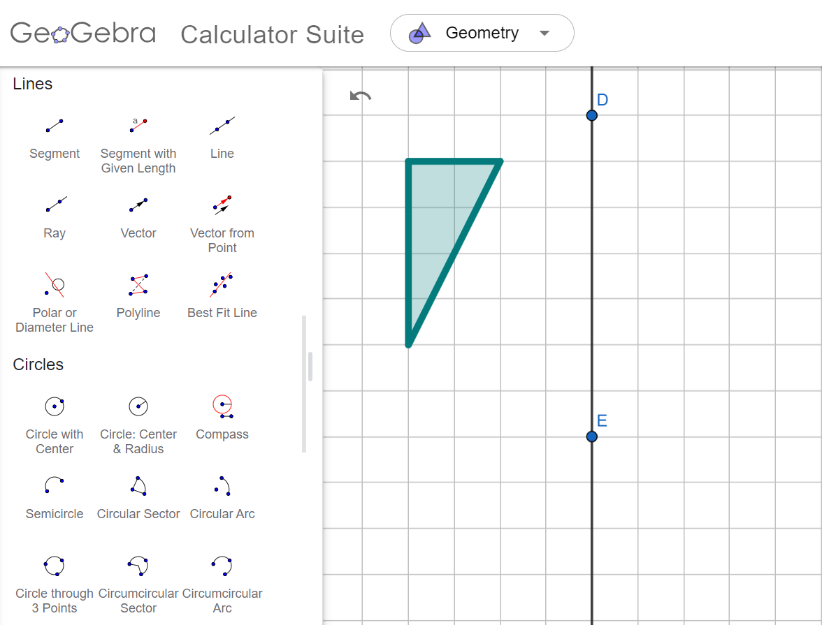
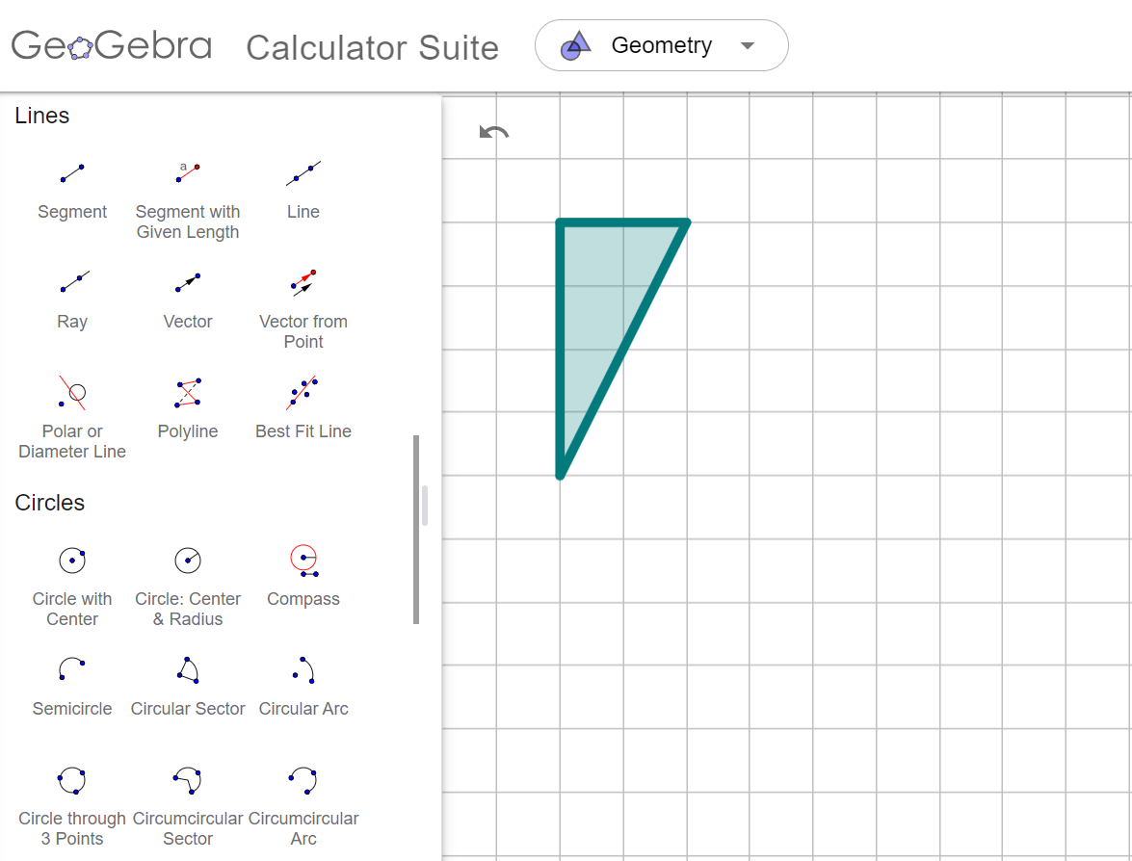
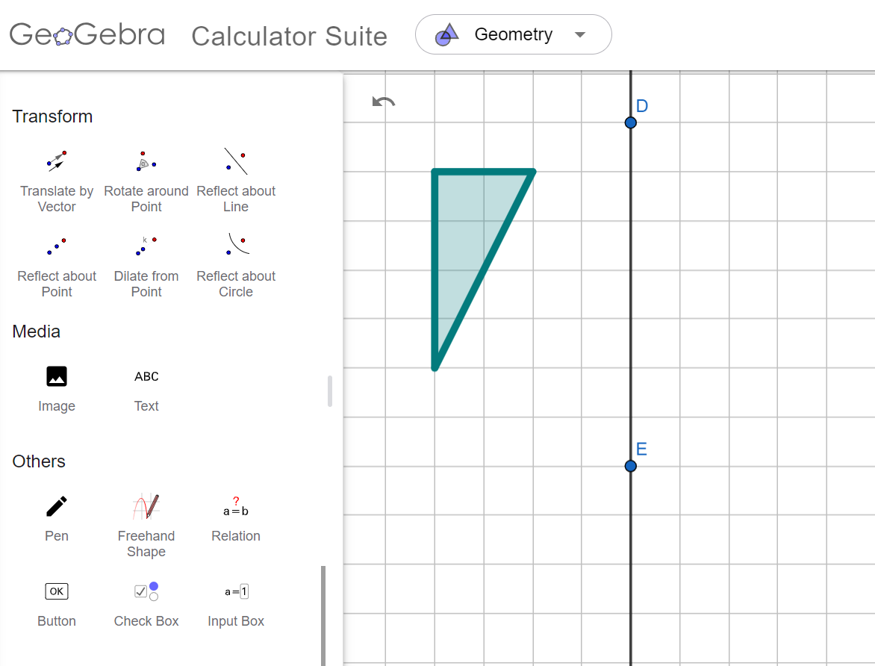
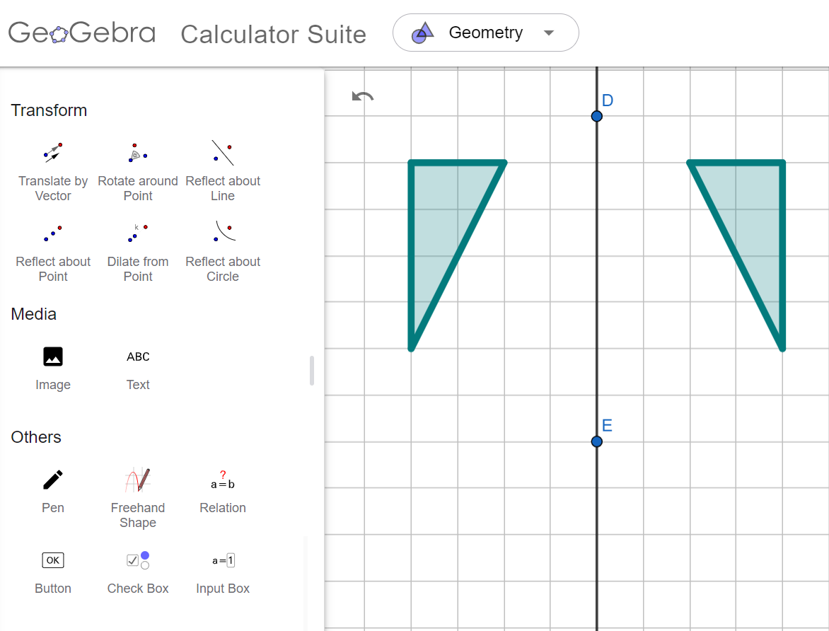
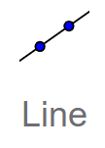
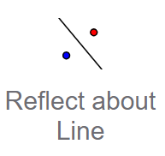
Using GeoGebra for reflections and translations
How to reflect an object:
Find and click the ‘line’ tool.
Click two points in the workspace to draw a line.
Click the ‘reflect about line’ tool.
Click the object and then the line of reflection.

Slide 22
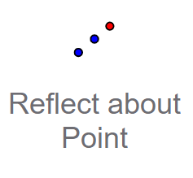
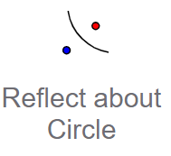
Using GeoGebra for reflections and translations
Which tool did the example use to reflect an object?

Slide 23
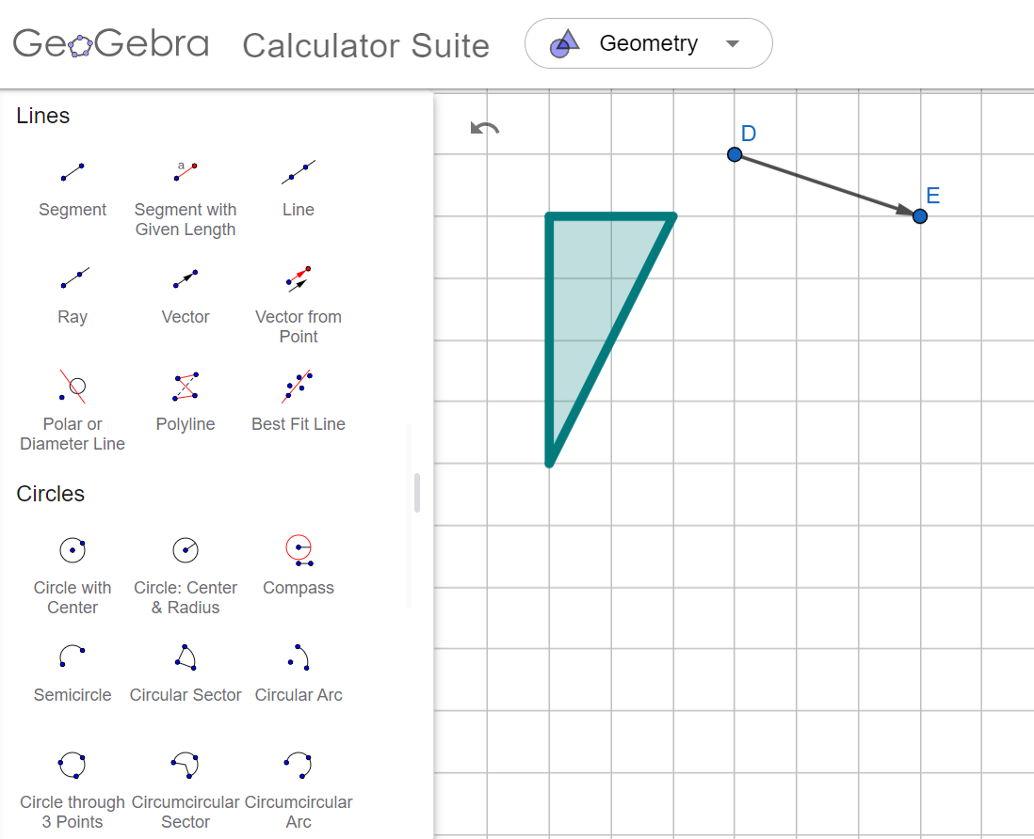
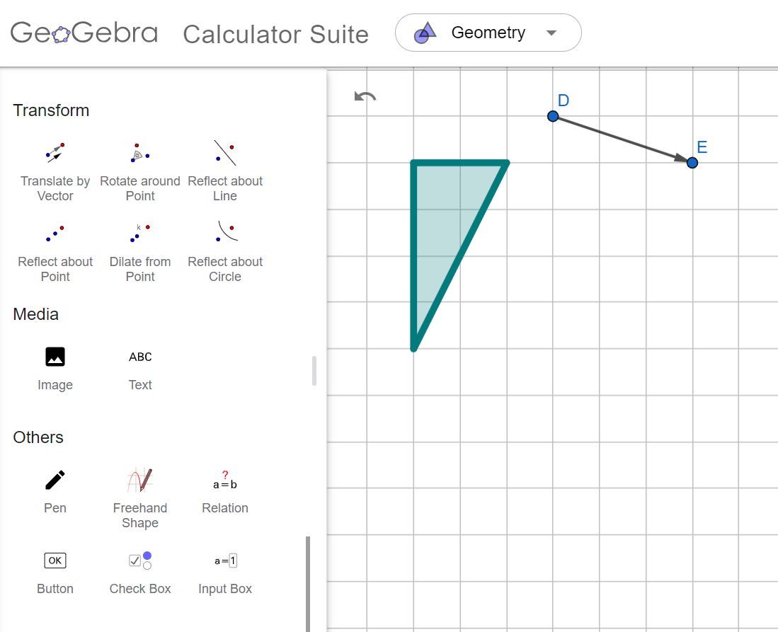
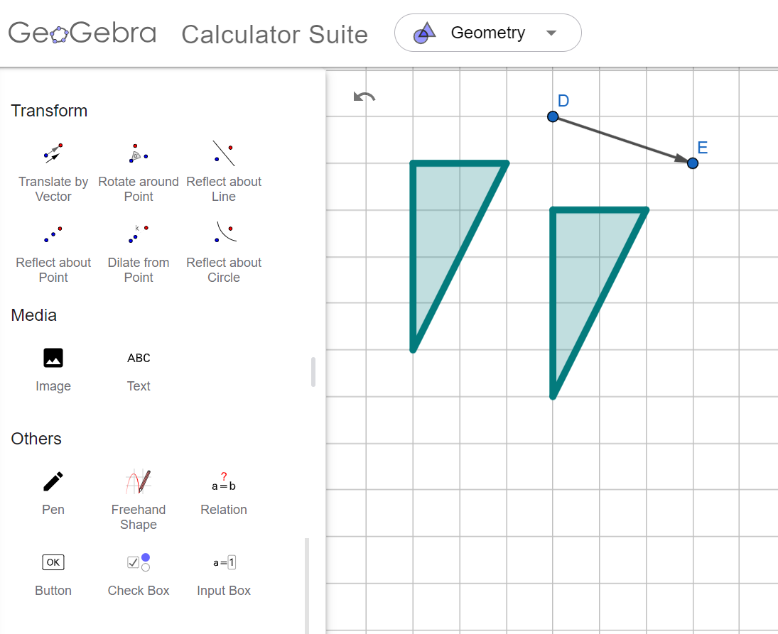

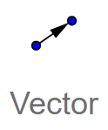
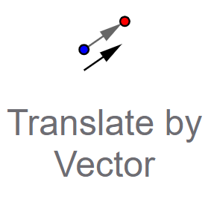
Using GeoGebra for reflections and translations
How to translate an object:
Find and click the ‘vector’ tool.
Click points in the workspace to draw a vector.
Click the ‘translate by vector’ tool.
Click the object and then the vector.

Slide 24
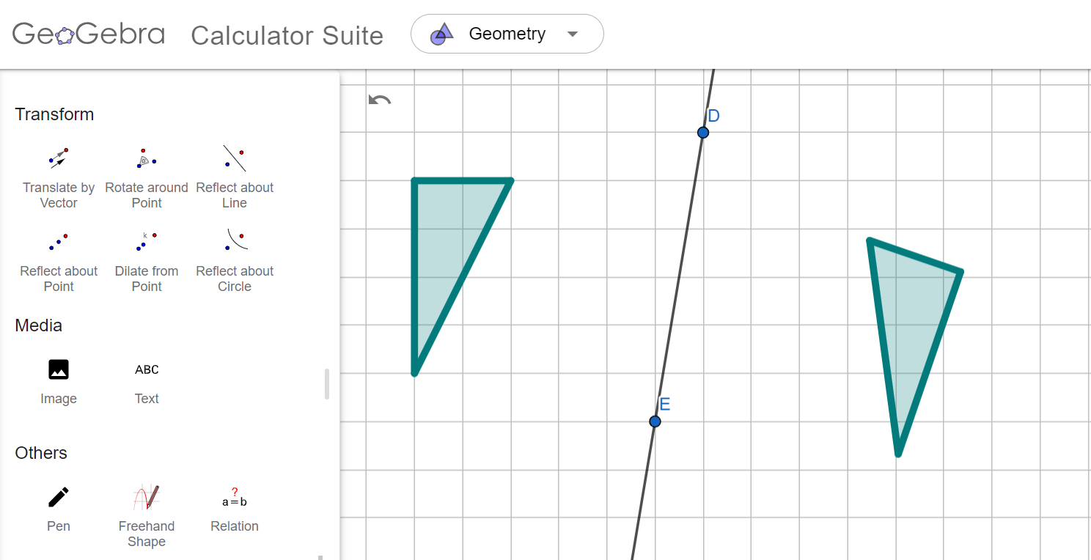
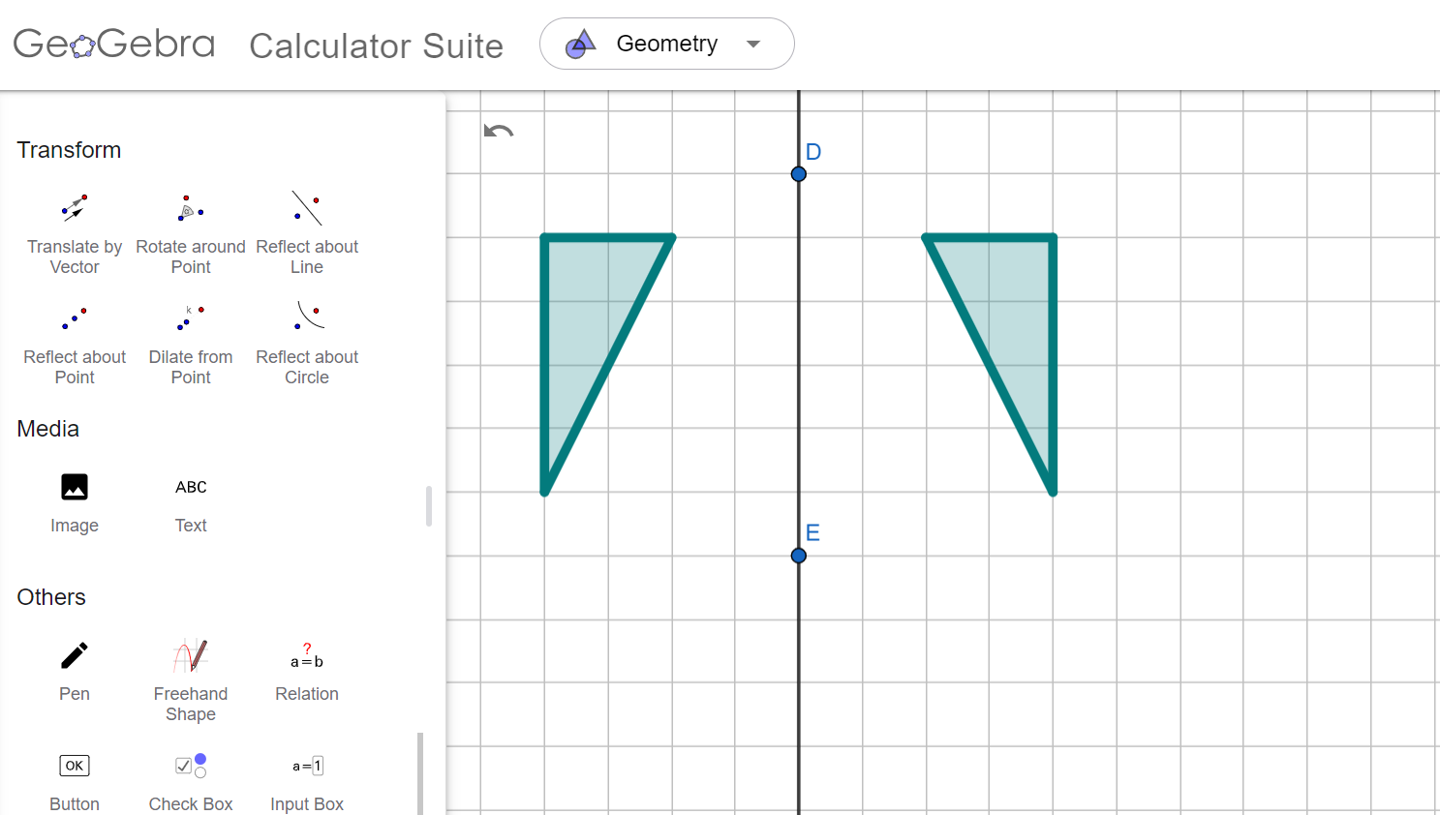
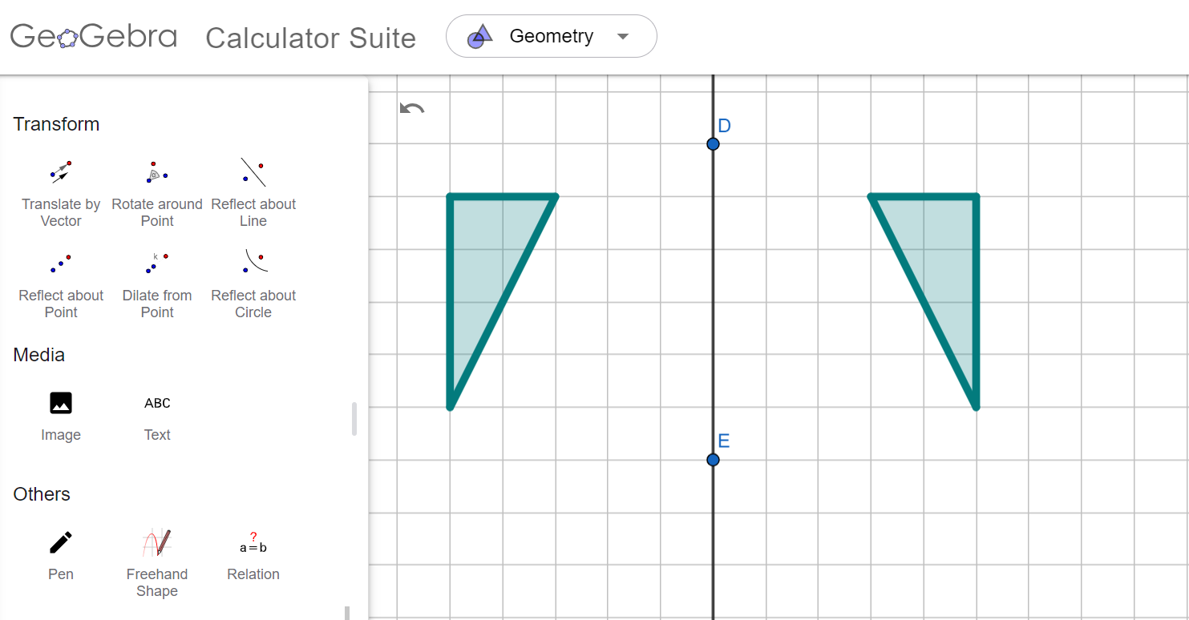
Using GeoGebra for reflections and translations
When doing reflections and translations on dynamic software, the lines and vectors can be manipulated after the image has been created.

Slide 25
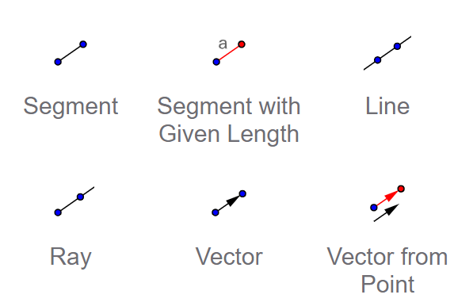
Using GeoGebra for reflections and translations
In addition to the translation tool, which other tool did the example use to translate an object?

Slide 26
Using GeoGebra for reflections and translations
1) Task B Question 1 🖇 Draw a line through points P and Q. Reflect object A over the line. Move the line of reflection down onto each of the numbered lines.
Which line reflects object A onto image A′?
2) Task B Question 2 🖇 Reflect object B over the line. Move point P to each of the number points to turn the line.
At which point does the line reflect object B onto image B′?

Slide 27
Using GeoGebra for reflections and translations
3) Task B Question 3 🖇 Translate each of the objects A to E using vectors 1 to 9. Which vector translates each object onto the image?
a) Vector translates object A onto the image.
b) Vector translates object B onto the image.
c) Vector translates object C onto the image.
d) Vector translates object D onto the image.
e) Vector translates object E onto the image.

Slide 28
Using GeoGebra for reflections and translations
1) Task B Question 1 🖇 Draw a line through points P and Q. Reflect object A over the line. Move the line of reflection down onto each of the numbered lines.
Which line reflects object A onto image A′?
2) Task B Question 2 🖇 Reflect object B over the line. Move point P to each of the number points to turn the line.
At which point does the line reflect object B onto image B′?
Line 4
Point 6

Slide 29
Using GeoGebra for reflections and translations
3) Task B Question 3 🖇 Translate each of the objects A to E using vectors 1 to 9. Which vector translates each object onto the image?
a) Vector translates object A onto the image.
b) Vector translates object B onto the image.
c) Vector translates object C onto the image.
d) Vector translates object D onto the image.
e) Vector translates object E onto the image.
6
4
9
8
3

Slide 30
Investigating transformations with GeoGebra
Using GeoGebra for rotations and enlargements
Using GeoGebra for reflections and translations
Using GeoGebra to identify transformations

Slide 31
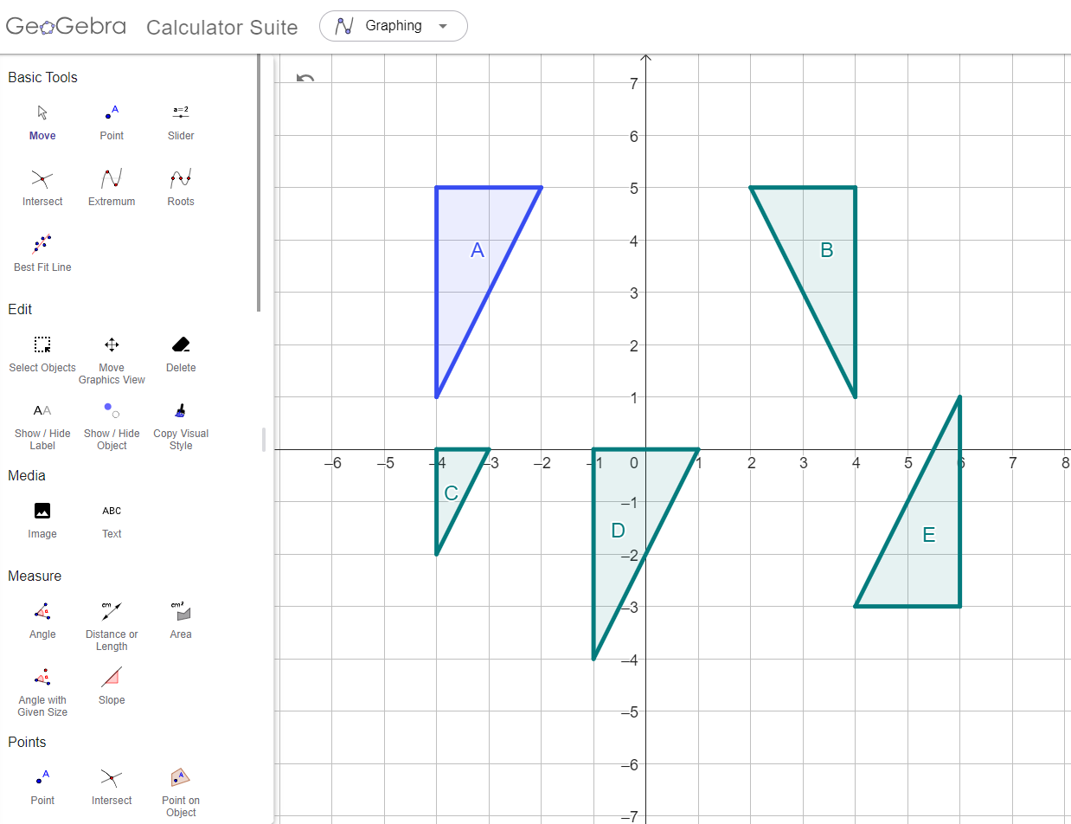
Using GeoGebra to identify transformations
Find the transformations that map object A onto images B, C, D and E.
This is an interactive version of the task 🖇

Slide 32
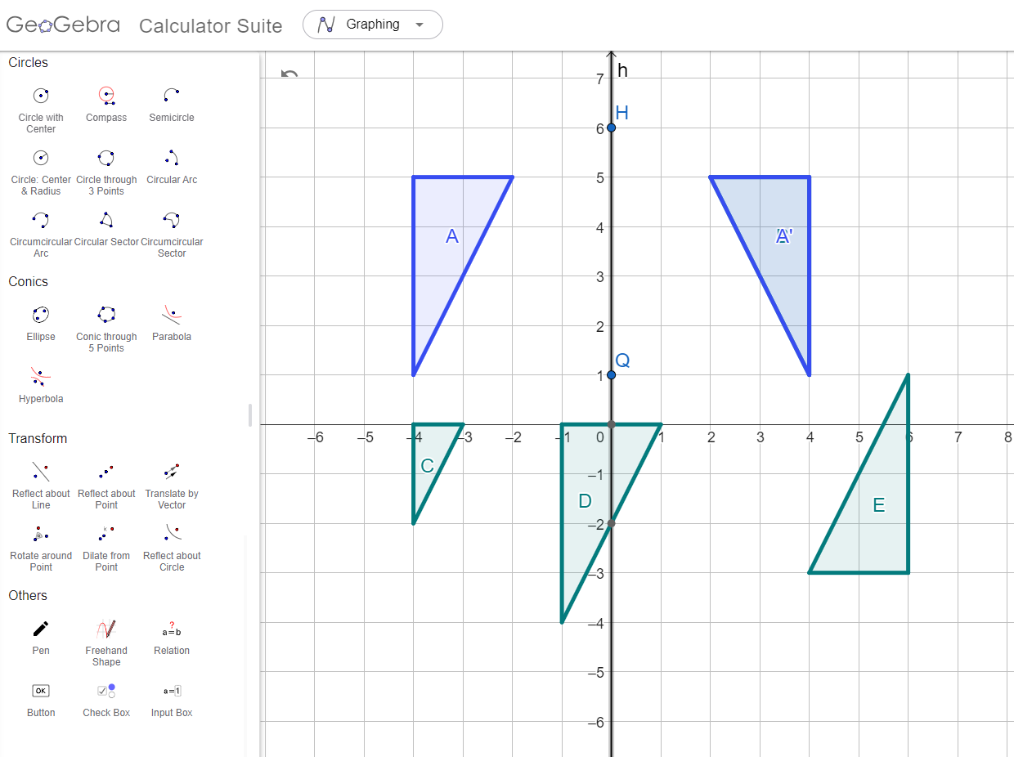
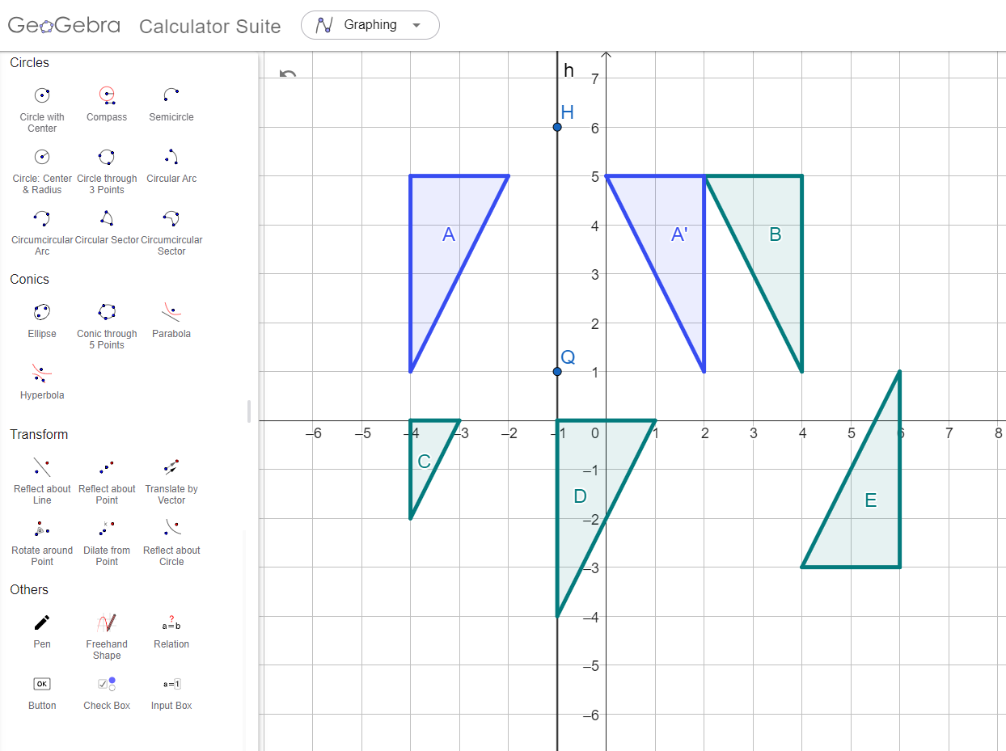
Using GeoGebra to identify transformations
Find the transformations that map object A onto images B, C, D and E.
A ↦ B is a reflection
over the y-axis.
Move the line to locate the line of reflection.

Slide 33
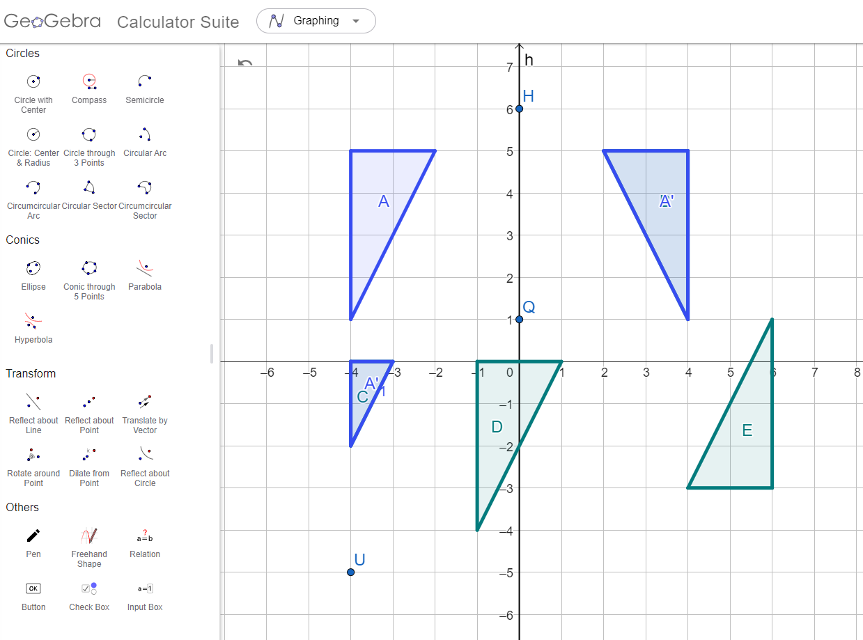
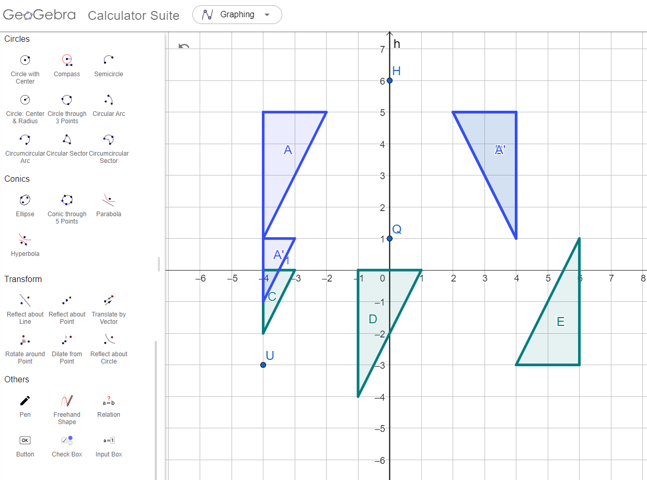
Using GeoGebra to identify transformations
Find the transformations that map object A onto images B, C, D and E.
A ↦ C is an enlargement
with scale factor
from (-4, -5).
Move the point to locate the centre of enlargement.

Slide 34
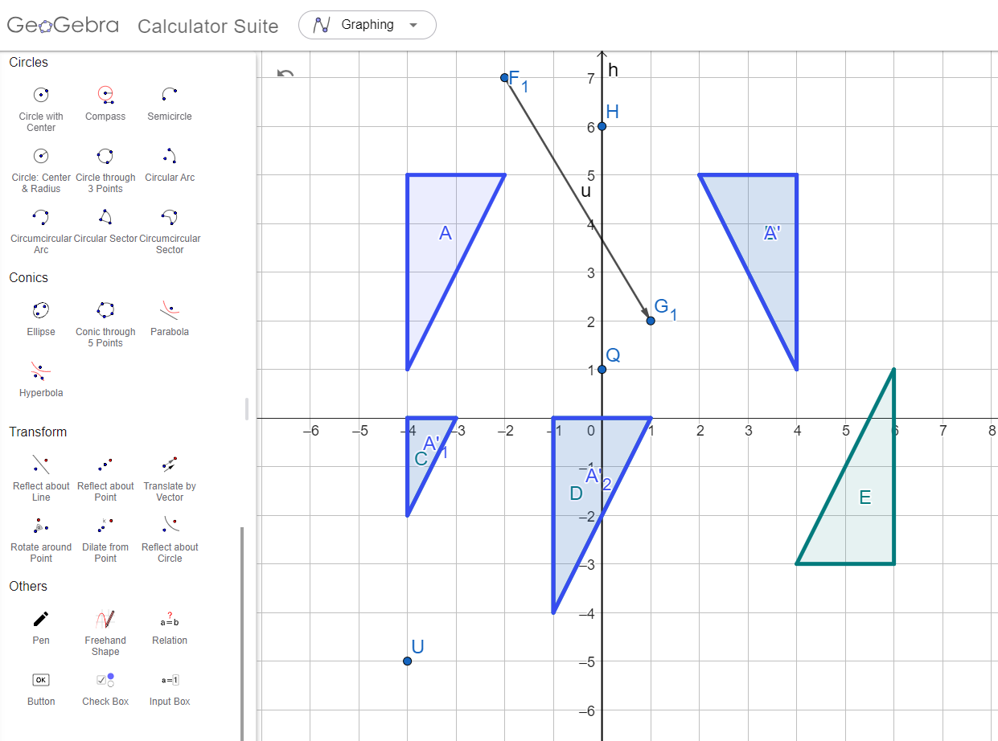
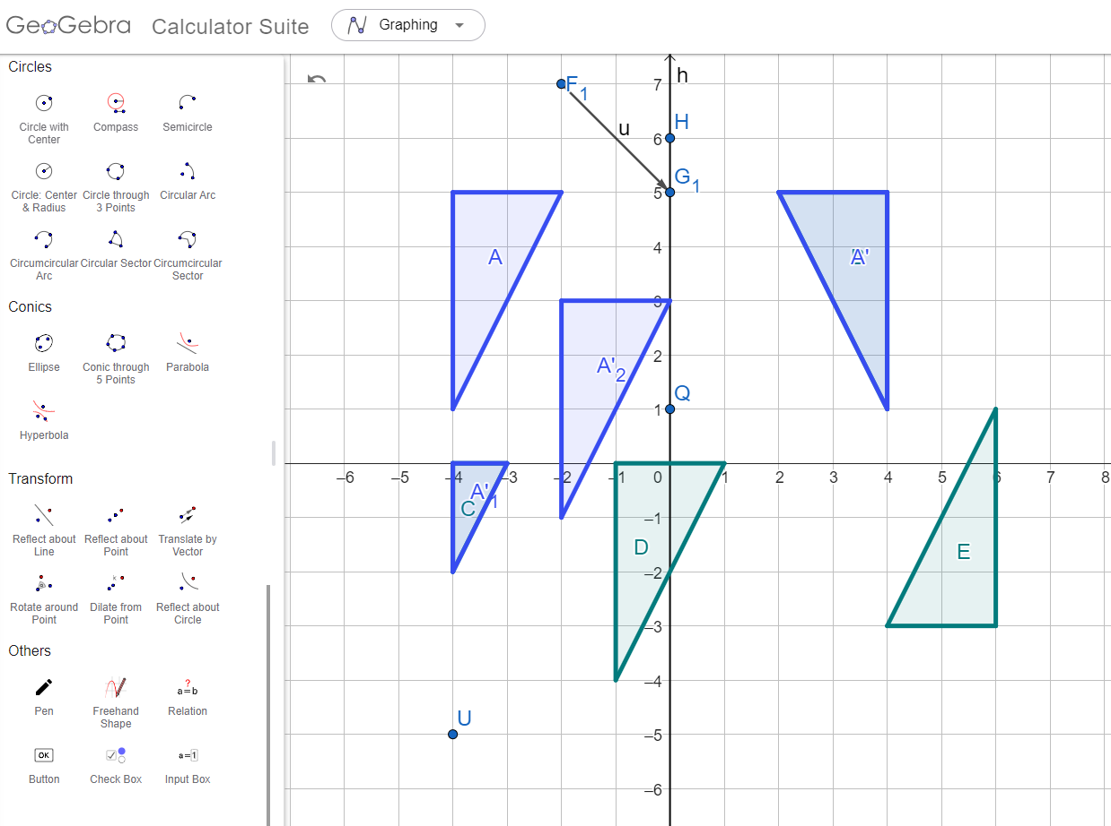
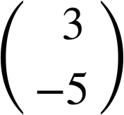
Using GeoGebra to identify transformations
Find the transformations that map object A onto images B, C, D and E.
A ↦ D is a translation
by .
Move the points to determine the vector.

Slide 35
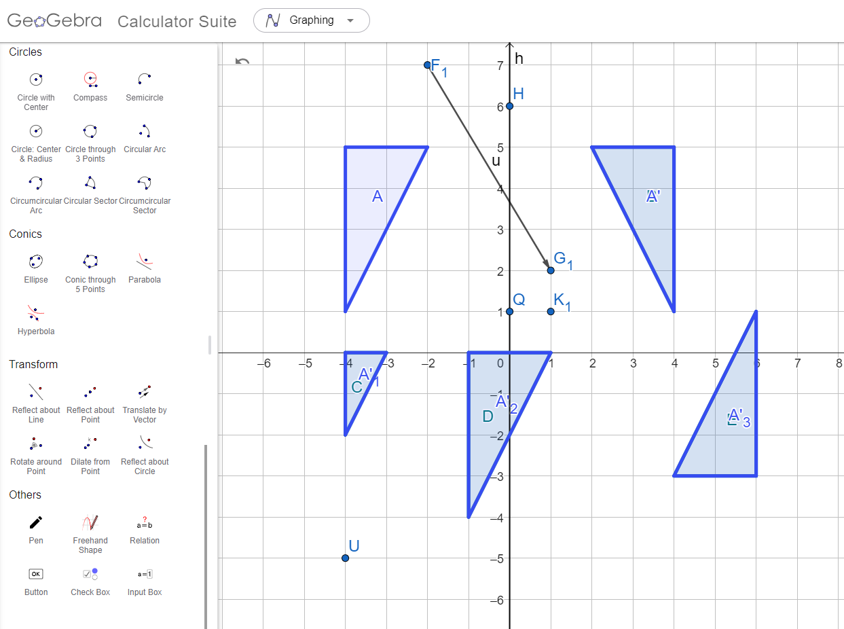
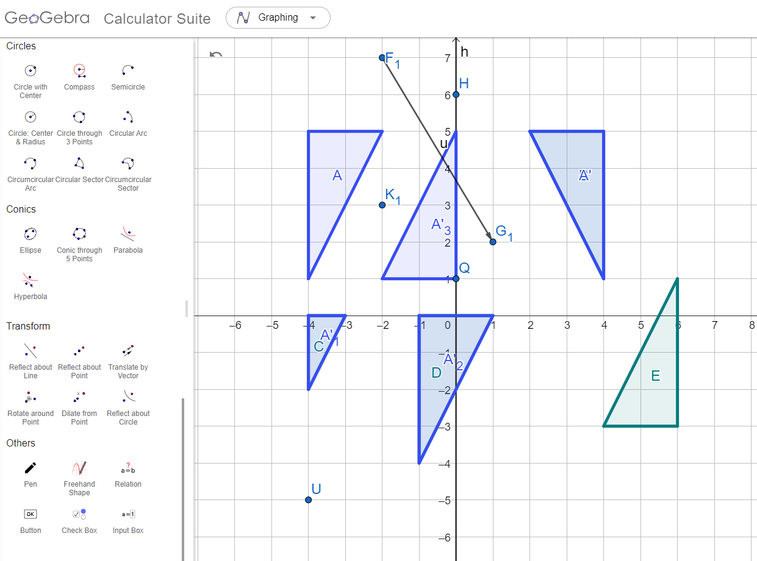
Using GeoGebra to identify transformations
Find the transformations that map object A onto images B, C, D and E.
A ↦ E is a rotation of 180°
around (1, 1).
Move the point to locate the centre of rotation.

Slide 36
Using GeoGebra to identify transformations
Which transformation has occurred?
enlargement
reflection
rotation
translation

Slide 37
Using GeoGebra to identify transformations
Which transformation has occurred?
enlargement
reflection
rotation
translation

Slide 38
Using GeoGebra to identify transformations
Which transformation has occurred?
enlargement
reflection
rotation
translation

Slide 39
Using GeoGebra to identify transformations
Task C 🖇 Find and describe each transformation below.
1. A ↦ B 2. A ↦ C 3. A ↦ D 4. A ↦ E

Slide 40
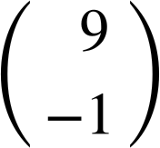
Using GeoGebra to identify transformations
Task C 🖇 Find and describe each transformation below.
1. A ↦ B 2. A ↦ C 3. A ↦ D 4. A ↦ E
Rotated 90° clockwise around (0, 1).
Translated .
Reflected over the x-axis.
Enlarged by a scale factor of 3 from (-6, 6).

Slide 41
Investigating transformations with GeoGebra
Dynamic geometry software can be used to quickly draw shapes and transform them.
Dynamic software allows us to manipulate aspects of a diagram after a transformation has already taken place.
Sliders can be used to make values such as angles and scale factors dynamic.

Slide 42

© Oak National Academy 2023.
Produced in partnership with Mathematics in Education and Industry.
Licensed on the Open Government Licence v3.0, except where otherwise stated. See Oak terms and conditions.

